Slide 1
Origins of elements
How scientific evidence of the Big Bang theory, gives us a glimpse of the origin of elements, of the divine Architect, who thoughtfully designed this universe.

Slide 2

What do you see?
Notes:
The Creation Story
Day 1 - God creates light. God divided light from darkness. He called the light 'day', and the darkness 'night'. (Genesis 1:3-5)
Day 2 - God creates a firmament in the midst of the waters and divides the waters from the waters. God calls the firmament Heaven. (Genesis 1:6-8)
Day 3 - God makes dry land to appear, and names the land earth and the waters sea. God commands the earth to bring forth grass, plants, and fruit bearing trees. (Genesis 1:9-13)
Day 4 - God creates light in the heavens to divide the day from night, and let them be for signs, for seasons, days and years. (Genesis 1:14-19)
Day 5 - God created sea creatures and birds. (Genesis 1:20-24)
Day 6 - God created man. (Genesis 1:26-27)
Day 7 - God rested. (Genesis 2:3)
https://www.saintjohnsbible.org/

Slide 3
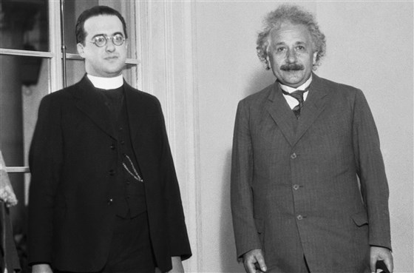
Who came up with the Big Bang Theory?
In the 1920s, a Belgian physicist and Roman Catholic priest named Georges Lemaître, speculated that if the history of the universe could be “run backward,” the universe would become denser and hotter (as well as smaller) until all the matter was concentrated in what he called a “primeval atom” — what we now call the Big Bang. video
Monsignor Georges LeMaitre is seen here with Dr. Albert Einstein at the California Institute of Technology in 193
Bettmann Archive / Getty Images.
Notes:
https://www.nbcnews.com/mach/science/what-big-bang-theory-ncna881136#anchor-WhocameupwiththeBigBangtheory
Monsignor Georges LeMaitre “We may speak of this event as of a beginning. I do not say a creation. Physically it is a beginning in the sense that if something happened before, it has no observable influence on the behavior of our universe, as any feature of matter before this beginning has been completely lost by the extreme contraction at the theoretical zero. Any preexistence of the universe has a metaphysical character. Physically, everything happens as if the theoretical zero was really a beginning. The question if it was really a beginning or rather a creation, something started from nothing, is a philosophical question which cannot be settled by physical or astronomical considerations.”²³ Ibid., 170.
LaMaitre is making a distinction between “beginning” and “creation”. When we speak of a physical or astronomical event we often use the terms “cause” and “effect” or “beginning”. However, any discussion of “creation” and what happened “before creation” is a philosophical (specifically, metaphysical) question which transcends the senses and is outside of our physical and astronomical understandings.
Later, there is a video (slide 19) highlighting 3 of St. Thomas Aquinas’ arguments for the existence of God.
1.God is the “unmoved mover” who sets all of creation into motion. (Students can benefit from a video of dominos falling to illustrate the notion of things being set into motion. https://www.youtube.com/watch?v=bUl295oyeIc )
2. God is the “first cause” or “uncaused cause”. God is not physical or astronomical and cannot be understood in our typical explanations of cause and effect.
3. God is the “necessary being”. The video narrator explains, “God has always existed and our world finds necessity in his existence.” All being comes from God. God is the creator who “always is, was, and will be”, who created “ex nihilo” -- from nothing.
Georges LaMaitre Father of the Big Bang video (4 min)
https://www.vofoundation.org/blog/priests-science-georges-lemaitre-father-big-bang/
https://www.catholicculture.org/culture/library/view.cfm?recnum=8847
https://web.archive.org/web/20130117044852/http://www.amnh.org/education/resources/rfl/web/essaybooks/cosmic/p_lemaitre.html

Slide 4
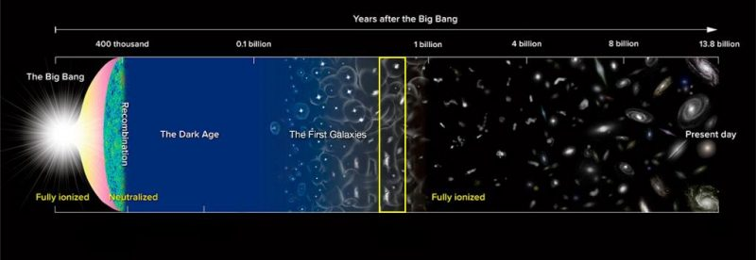
Big Bang and the forming of the universe
.
Notes:
The Universe came into existence approximately 14 billions years ago.
Light and matter separated after a few hundred thousand years later.
A dark age was followed by formation of the first stars (100 millions years later).
Galaxies already assembled a billion years after the Big Bang.
Our Galaxy is one of the 100+ billion galaxies.

Slide 5
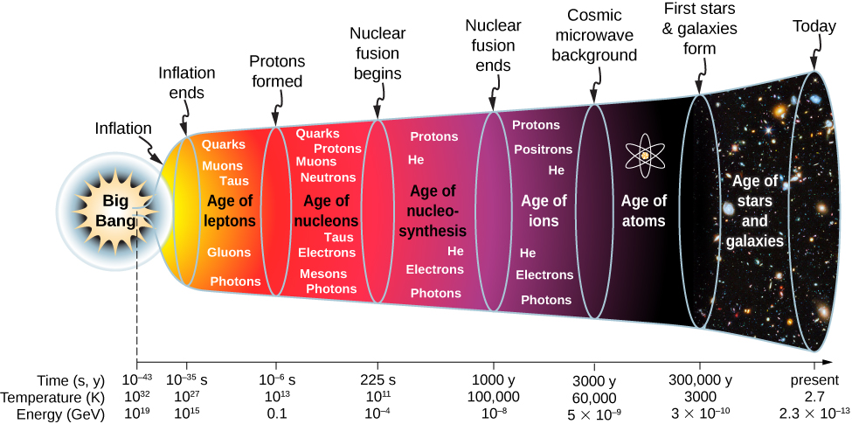
Timeline of formation of protons, neutrons, atoms ...
Notes:
Before the short period of cosmic inflation, cosmologists believe that all matter in the universe was squeezed into a space much smaller than an atom. Cosmologists further believe that the universe was extremely dense and hot, and interactions between particles were governed by a single force. In other words, moving backwards in time, the four fundamental forces (strong nuclear, electromagnetic, weak nuclear, and gravitational) merge into one at these energies.
https://phys.libretexts.org/Bookshelves/University_Physics/Book%3A_University_Physics_(OpenStax)/Map%3A_University_Physics_III_-_Optics_and_Modern_Physics_(OpenStax)/11%3A_Particle_Physics_and_Cosmology/11.7%3A_Evolution_of_the_Early_Universe

Slide 6
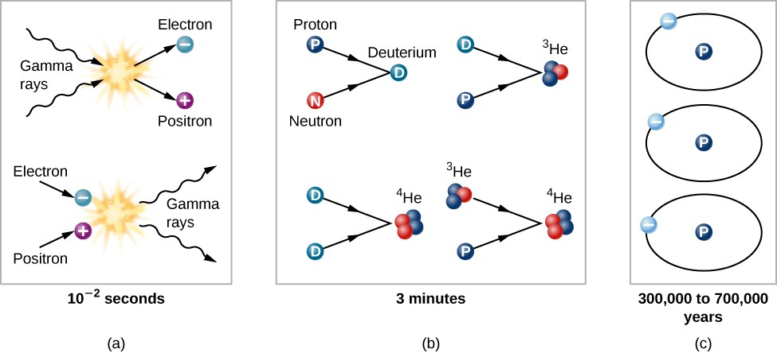
Nucleosynthesis is a process by which the chemical elements in the universe were made through nuclear fusion
Notes:
By the time the universe was 0.01 second old, it consisted of a soup of matter and radiation; the matter included protons and neutrons, leftovers from an even younger and hotter universe. Each particle collided rapidly with other particles. The temperature was no longer high enough to allow colliding photons to produce neutrons or protons, but it was sufficient for the production of electrons and positrons (Figure 4). There was probably also a sea of exotic subatomic particles that would later play a role as dark matter. All the particles jiggled about on their own; it was still much too hot for protons and neutrons to combine to form the nuclei of atoms.
https://courses.lumenlearning.com/astronomy/chapter/the-beginning-of-the-universe/

Slide 7
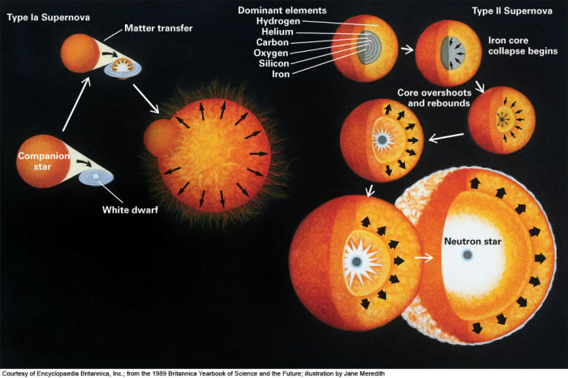
The origin of elements video
Photo credit:
www.ifa.hawaii.edu
Notes:
(video 1.55 min) Are we made of stars? This video from NOVA features scientists studying light emissions from exploding stars, called supernovas. Their observations and analyses can tell us the origin of the elements found on Earth and throughout the universe.
https://dptv.pbslearningmedia.org/resource/phy03.sci.phys.matter.origin/the-origin-of-the-elements/

Slide 8
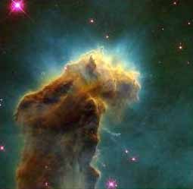
Synthesis of heavier elements
This video segment adapted from NOVA illustrates the critical role that stars play in creating the elements.
Notes:
( video 3.42 min) Elements heavier than lithium are all synthesized in stars. During the late stages of stellar evolution, massive stars burn helium to carbon, oxygen, silicon, sulfur, and iron. Elements heavier than iron are produced in two ways: in the outer envelopes of supergiant stars and in the explosion of a supernovae. All carbon-based life on Earth is literally composed of stardust.
https://dptv.pbslearningmedia.org/resource/ess05.sci.ess.eiu.fusion/the-elements-forged-in-stars/

Slide 9
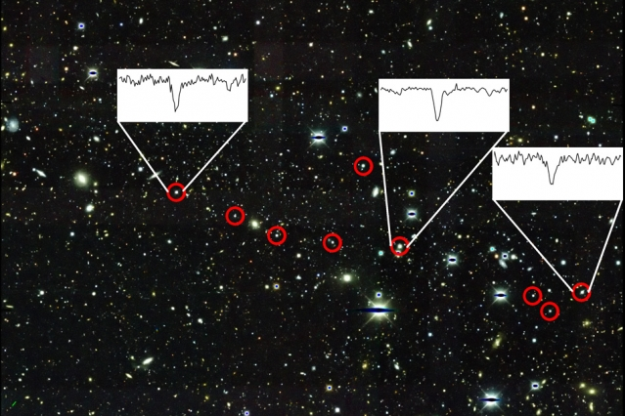
How were the heaviest elements identified
in the cosmos?
Notes:
Carl Sagan popularized the notion that we are all made of star stuff. He could say so with confidence because we actually know where nearly every element in the periodic table is made in the universe. But there's a hole in our understanding. The heaviest elements are made in what is called the "rapid neutron-capture process," or "r-process" for short, in which heavy elements are quickly built up from lighter seed nuclei. Gold, platinum, and uranium are r-process elements, as are more exotic elements like europium, neodymium, and gadolinium.
Credits Massachusetts Institute of Technology https://phys.org/news/2016-03-cosmos-heaviest-elements.html

Slide 10
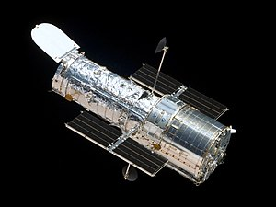
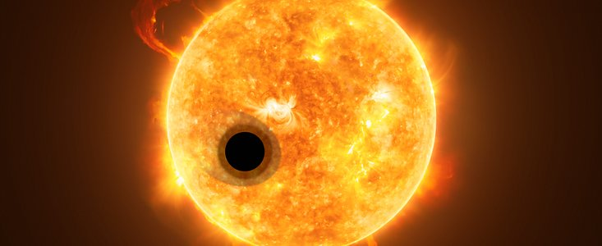
Hubble Space Telescope gives astronomers clear views of the universe in visible, infrared and ultraviolet light
Hubble detects helium in the atmosphere of an exoplanet for the first time
Notes:
Photo credit NASA
http://hubblesite.org/image/4370/news
Astronomers using the NASA/ESA Hubble Space Telescope have detected helium in the atmosphere of the exoplanet WASP-107b. This is the first time this element has been detected in the atmosphere of a planet outside the Solar System. The discovery demonstrates the ability to use infrared spectra to study exoplanet extended atmospheres.
https://www.spacetelescope.org/news/heic1809/

Slide 11
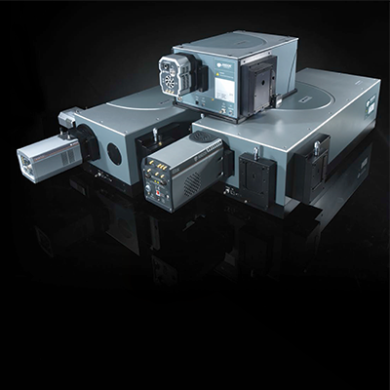
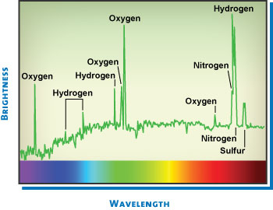
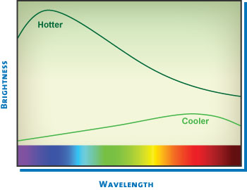
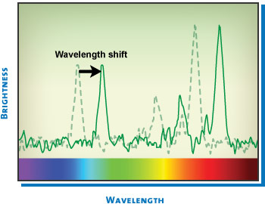
Why Look at Spectra? We can learn much about cosmic objects by looking at images, but even more by looking at their light. We use instruments like spectrographs that break light into colors, revealing: - temperature,
- composition,
- density,
- motion
Notes:
TEMPERATURE: The shape of a star’s spectrum reveals its temperature. Spectra that peak near the blue end of the scale indicate young stars that burn hot. Spectra that peak closer to the red end of the scale indicate stars with cooler temperatures. WHAT IT TELLS US: Hot stars burn through their fuel quickly, dying in less than 50 million years. (Our Sun, in contrast, will burn for about 10 billion years.) So astronomers know that when they find a hot, blue star, that star is always young. Astronomers can classify entire galaxies by whether they contain mostly blue stars or mostly red stars, and they can trace the history of galaxies by the studying combinations of stars they contain.
COMPOSITION:Peaks and dips at specific points in a spectrum indicate the presence of elements like carbon, oxygen, hydrogen, iron, and more. That information can be used to make other conclusions about the object. Stars that contain just hydrogen and helium, for example, formed early in the universe. Stars with heavier elements formed later, after their predecessors exploded and seeded the universe with those elements. WHAT IT TELLS US: Shortly after the Big Bang, nearly all the universe’s matter was made up of light elements, particularly hydrogen and helium. The earliest stars created the heavier elements – like carbon, nitrogen, oxygen, and iron – in the cores. By studying the spectra of the stars and the gas between the stars, we can learn how the universe evolved from the Big Bang to the present. We can also use spectra to study the composition of planets around other stars for components like water, which is essential for the rise of life.
MOTION: Astronomers know where peaks and dips should be located in a spectrum. When those lines appear shifted, it means the object is in motion. The spectrum can be used to identify the object’s velocity and whether it’s moving toward us or away. WHAT IT TELLS US: The ability to learn the velocity of orbiting objects allows us to determine mass. We can use the information gleaned from spectra to find the mass of the Sun, other stars, black holes, galaxies, and even clusters of galaxies. Determining the velocity of galaxies has allowed us to discover that the universe is expanding, that a strange dark energy appears to be speeding the expansion, and that we are surrounded by invisible dark matter.
http://hubblesite.org/laserart/spectra.php
https://lot-qd.de/en/products/spectroscopy/spectrographs/

Slide 12
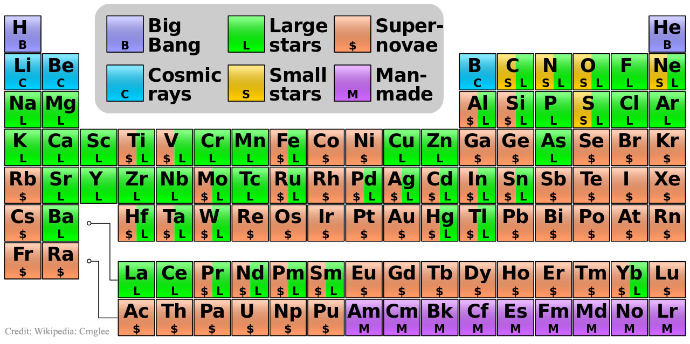
Notes:
Explanation:
The hydrogen in your body, present in every molecule of water, came from the Big Bang.
There are no other appreciable sources of hydrogen in the universe.
The carbon in your body was made by nuclear fusion in the interior of stars, as was the oxygen. Much of the iron in your body was made during supernovas of stars that occurred long ago and far away.
The gold in your jewelry was likely made from neutron stars during collisions that may have been visible as short-duration gamma-ray bursts.
Elements like phosphorus and copper are present in our bodies in only small amounts but are essential to the functioning of all known life.
The featured periodic table is color coded to indicate humanity's best guess as to the nuclear origin of all known elements.
https://apod.nasa.gov/apod/ap160125.html

Slide 13
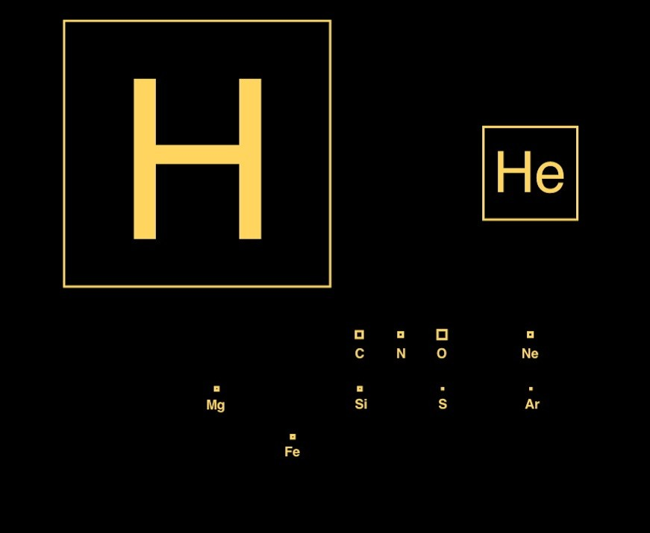
Abundance of elements in the universe
Hydrogen
Helium
Oxygen Carbon
Neon
...
Notes:
There’s an old joke that the astronomer’s periodic table consists of three elements: hydrogen, helium, and metal. It’s a nice joke, but when you understand how little of matter in the universe is “metal”, you can understand why astronomers focus on hydrogen and helium. You can see this in the figure, which gives the relative abundance of different elements by area, the larger the square, the more of that particular element there is. As you can see, most of the elements of the periodic table are too small to even appear. The few others that do show up are dwarfed by the hydrogen and helium squares.
https://archive.briankoberlein.com/2014/04/23/hydrogen-helium-metal/index.html

Slide 14
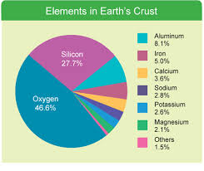
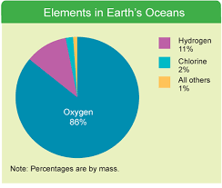
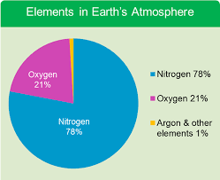
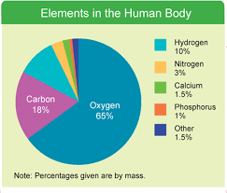
Abundance of elements on earth
Notes:
https://www.emsisd.com/cms/lib/TX21000533/Centricity/ModuleInstance/5456/Percentage_of_Elements_PowerPoint.pdf

Slide 15
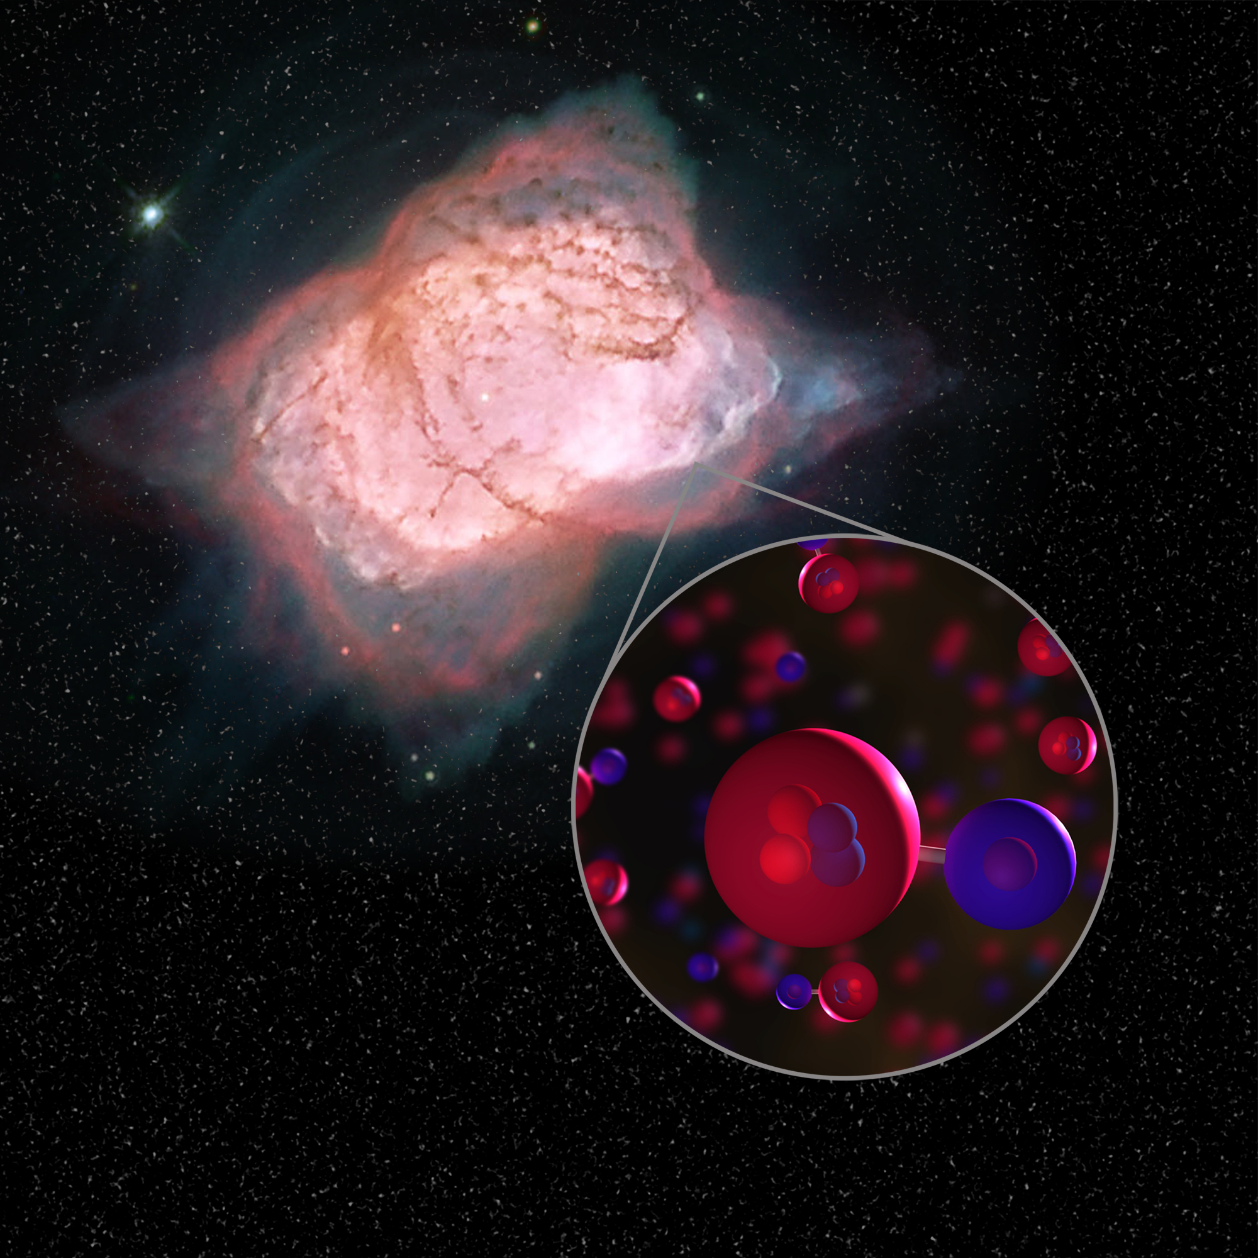
The Universe’s First Type of Molecule Is Found at Last
Helium hydride (He-H) should be present in some parts of the modern universe, but it has never been detected in space — until now.
Video
Notes:
2019
The first type of molecule that ever formed in the universe has been detected in space for the first time, after decades of searching. Scientists discovered its signature in our own galaxy using the world’s largest airborne observatory, NASA’s Stratospheric Observatory for Infrared Astronomy, or SOFIA, as the aircraft flew high above the Earth’s surface and pointed its sensitive instruments out into the cosmos.
https://www.nasa.gov/feature/the-universe-s-first-type-of-molecule-is-found-at-last

Slide 16
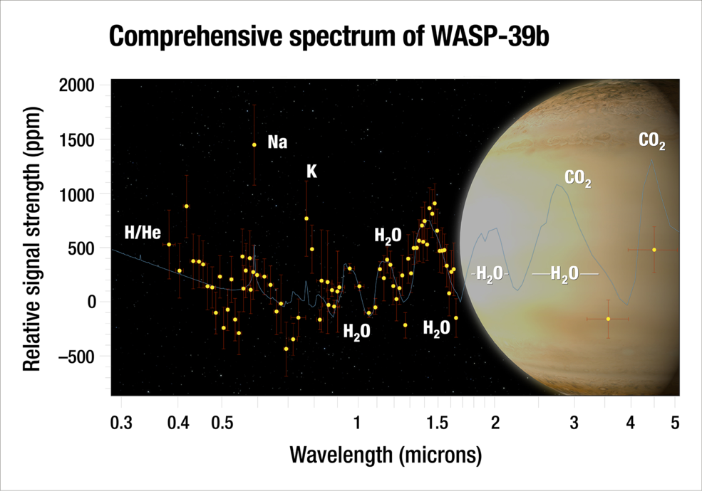
NASA Finds a Large Amount of Water in an Exoplanet's Atmosphere
Notes:
(2018) Much like detectives study fingerprints to identify the culprit, scientists used NASA’s Hubble and Spitzer space telescopes to find the “fingerprints” of water in the atmosphere of a hot, bloated, Saturn-mass exoplanet some 700 light-years away. And, they found a lot of water. In fact, the planet, known as WASP-39b, has three times as much water as Saturn does.
Though no planet like this resides in our solar system, WASP-39b can provide new insights into how and where planets form around a star, say researchers. This exoplanet is so unique, it underscores the fact that the more astronomers learn about the complexity of other worlds, the more there is to learn about their origins. This latest observation is a significant step toward characterizing these worlds.
https://www.nasa.gov/feature/goddard/2018/nasa-finds-a-large-amount-of-water-in-an-exoplanets-atmosphere

Slide 17
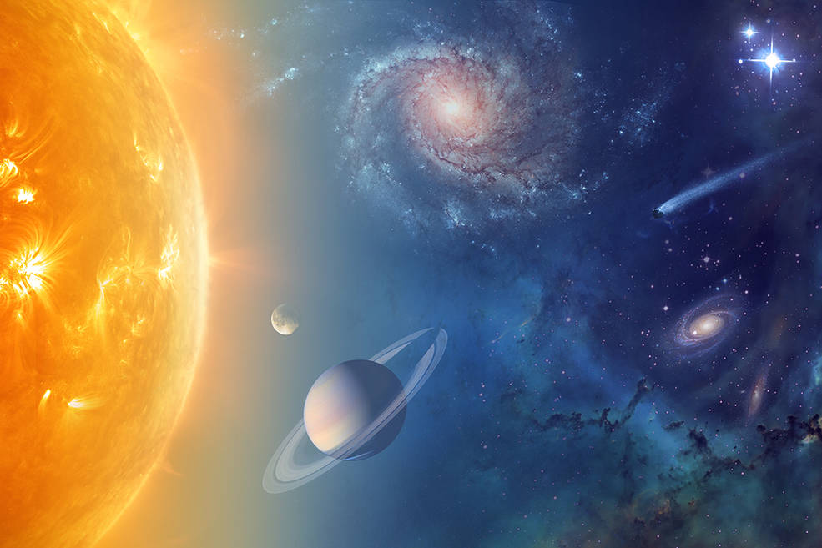
NASA is exploring our solar system and beyond to understand the workings of the universe, searching for water
and life among the stars
Notes:
The chemical elements in water, hydrogen and oxygen, are some of the most abundant elements in the universe. Astronomers see the signature of water in giant molecular clouds between the stars, in disks of material that represent newborn planetary systems, and in the atmospheres of giant planets orbiting other stars.
https://www.nasa.gov/jpl/the-solar-system-and-beyond-is-awash-in-water

Slide 18
Day 2
Using Philosophy to Build a Bridge between Science and Theology.
St. Thomas Aquinas was a 13th century Dominican monk who spent his entire life thinking about God and God’s relationship with the world, in general, and with humanity, in particular. Today, we see this as three or more disciplines but in the 13th century one could speak of these subjects together with ease.
Today, we see the study of the natural world as “science”, the study of God as “theology”, and the study of knowledge as “philosophy”. Today’s language requires us to use the language of philosophy -- logic, reasoning, and argumentation -- to talk about the relationship between “how” our world exists (science) and “why” it exists (theology).
The video below shows how Aquinas “proves” or “argues” for the existence of God.
Aquinas’ Proofs for the Existence of God

